Slide 1



SOFTWARE DEVELOPMENT PROFESSIONAL PROGRAM
Scrum

Slide 2





Scrum
Learning Objectives
Articulate the difference between Agile & Scrum
List common Scrum roles
List common Scrum ceremonies

Slide 3


Scrum
Quiz: Defining Agile
What is Agile?
A) A set of values and principles.
B) A list of dos and don'ts.
C) A specific language to program with.
D) A list of meetings and job titles.

Slide 4
Scrum
Quiz: Defining Agile Answers
What is Agile?
✅ A set of values and principles.
🚫 A list of dos and don'ts.
🚫 A specific language to program with.
🚫 A list of meetings and job titles.

Slide 5
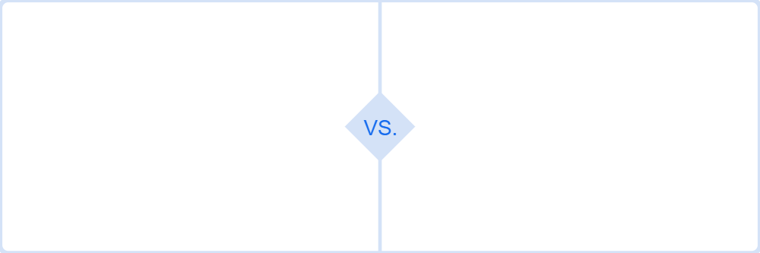
Scrum
Agile vs. Scrum
Agile
Scrum
Vague ideas that improve development:
Specific ideas that align with Agile:
Values
Principles
Ceremonies (Events)
Roles (Positions)
Notes:
Agile is like a university major-Music Theory, for example-that gives you a vague idea
of an educational experience.
Scrum is like a specific curriculum, with classes, hours, and learning objectives that very
clearly describe what the educational experience entails.

Slide 6

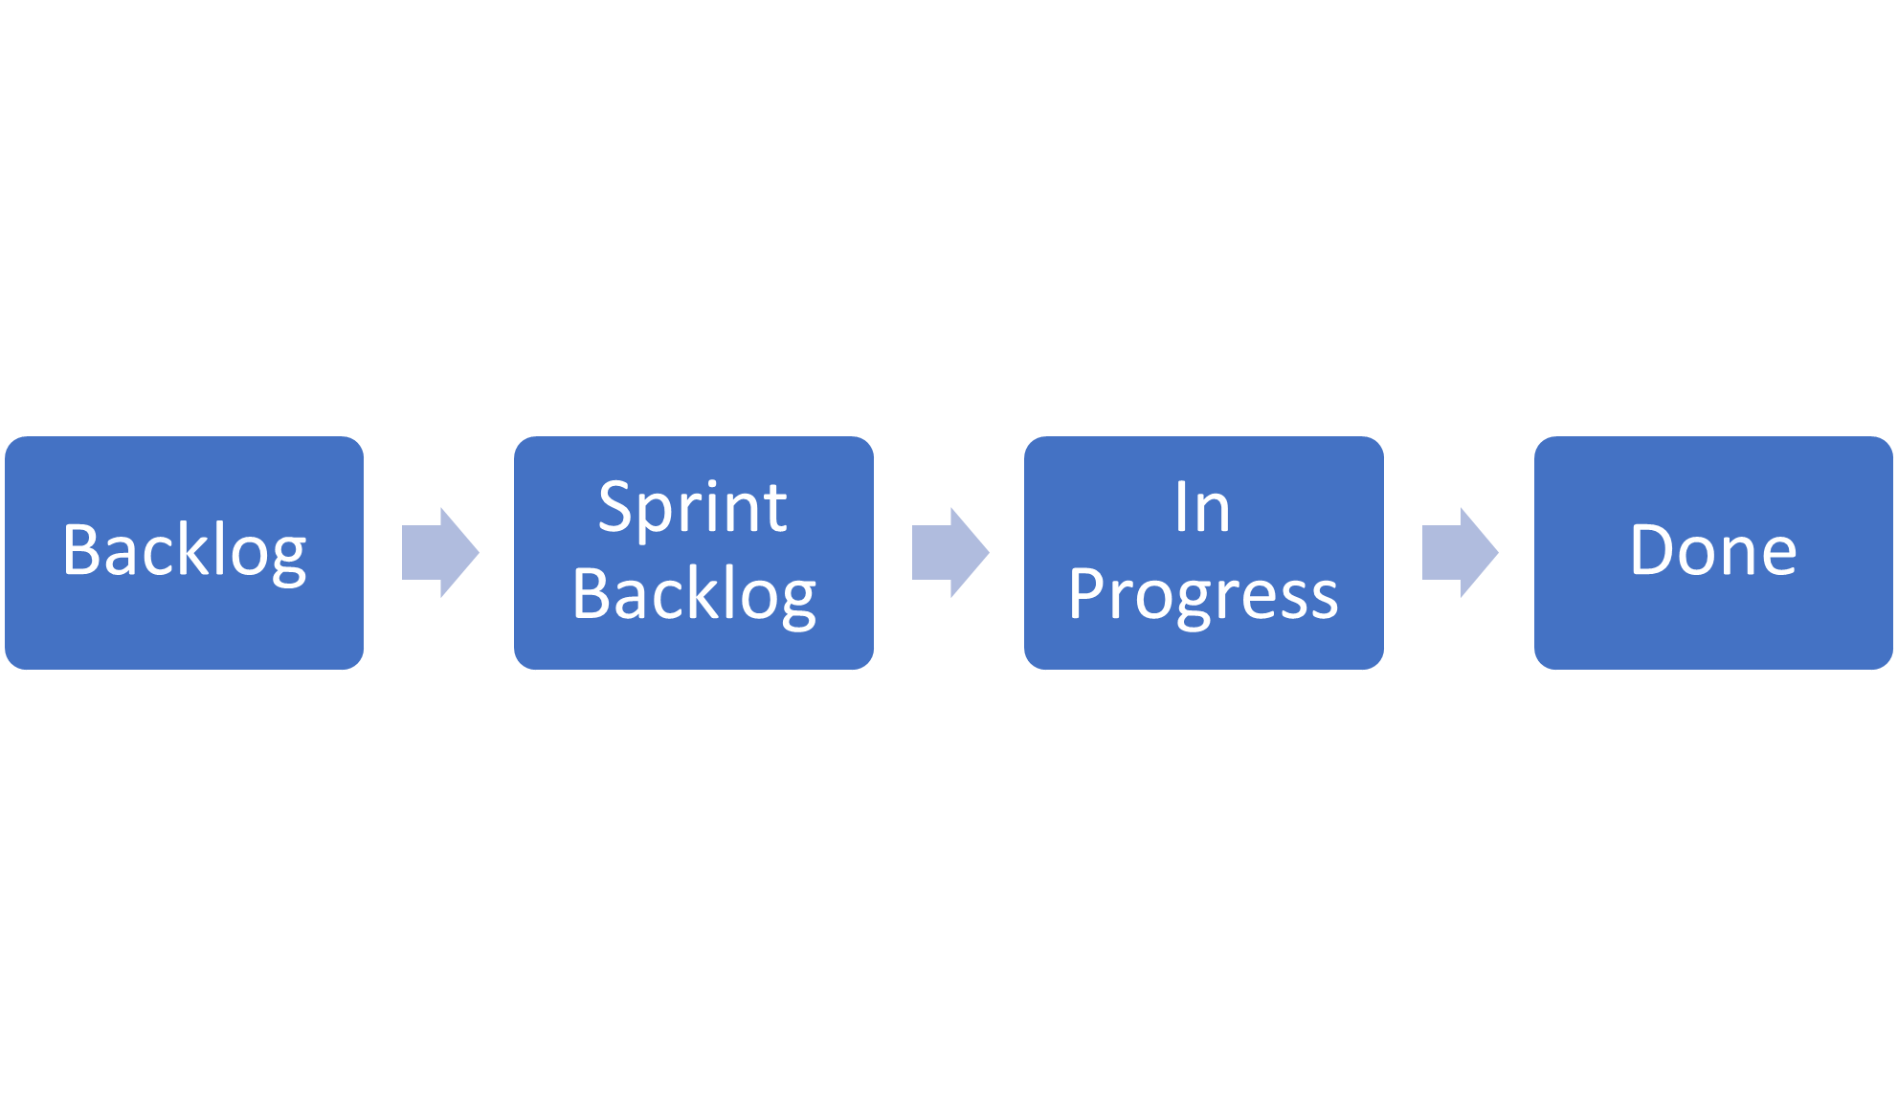
Scrum
Sprint
Scrum organizes work into one- to four-week time periods called sprints.
Throughout a sprint, specific tasks move across four distinct lists.

Slide 7
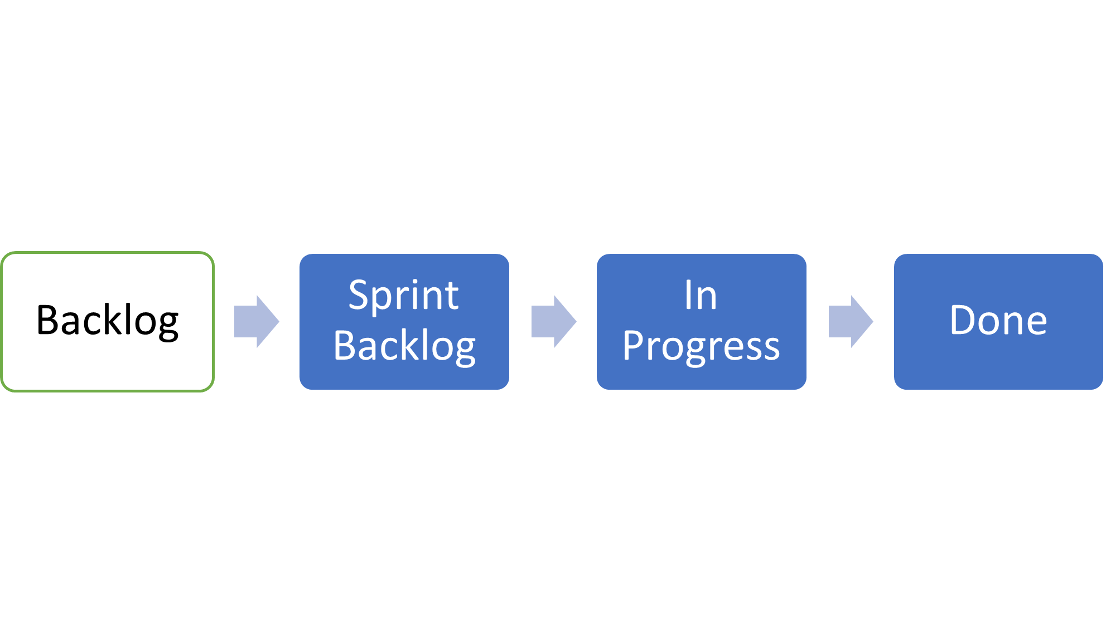
Scrum
1. The Backlog
A list of all the things that still need to be done on our project
Many tasks in this list won't be completed until a later sprint.

Slide 8
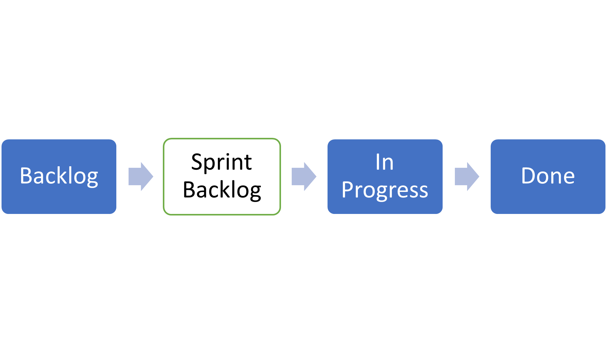
Scrum
2. The Sprint Backlog
A list of the things that should be done in the current sprint

Slide 9
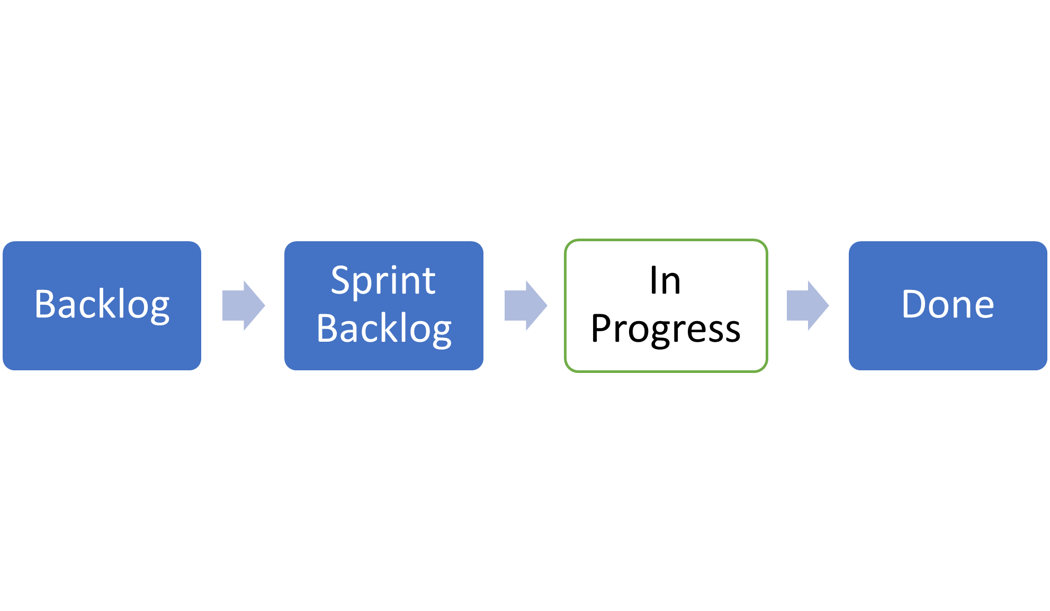
Scrum
3. In Progress
A list of things currently being worked on

Slide 10
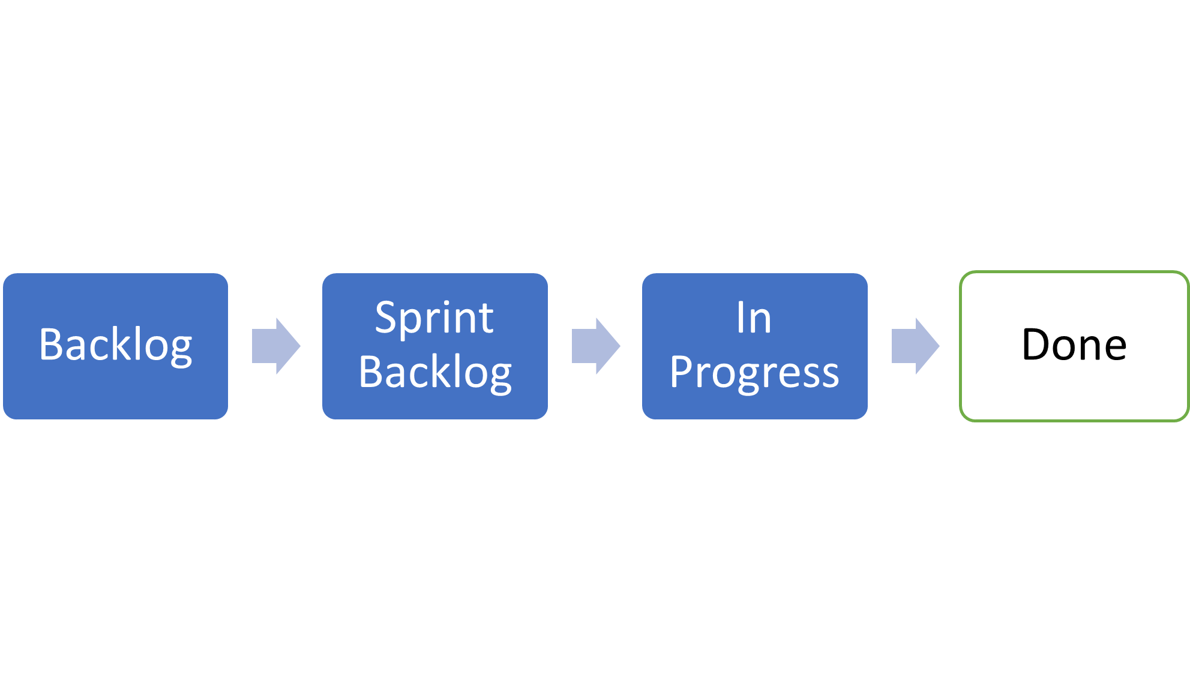
Scrum
4. Done
A list of things that are finished

Slide 11
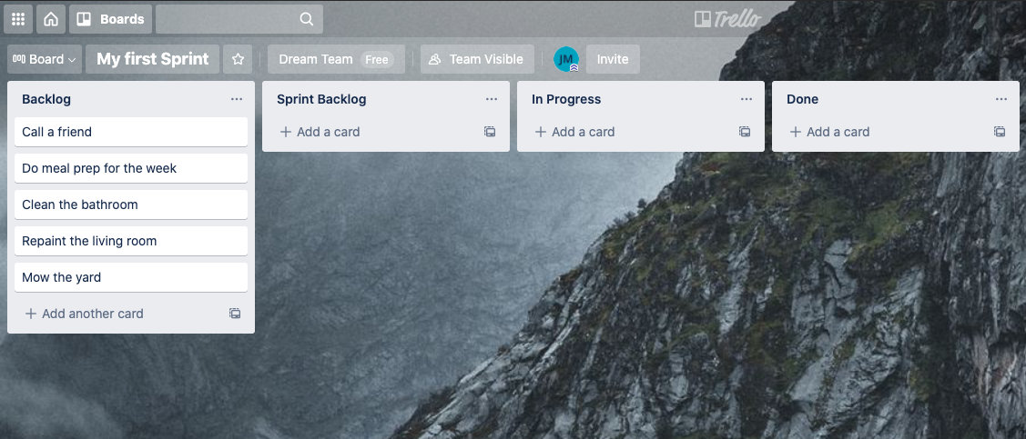
Scrum
Tracking Lists
Most Scrum teams use software to track these lists during a sprint.

Slide 12

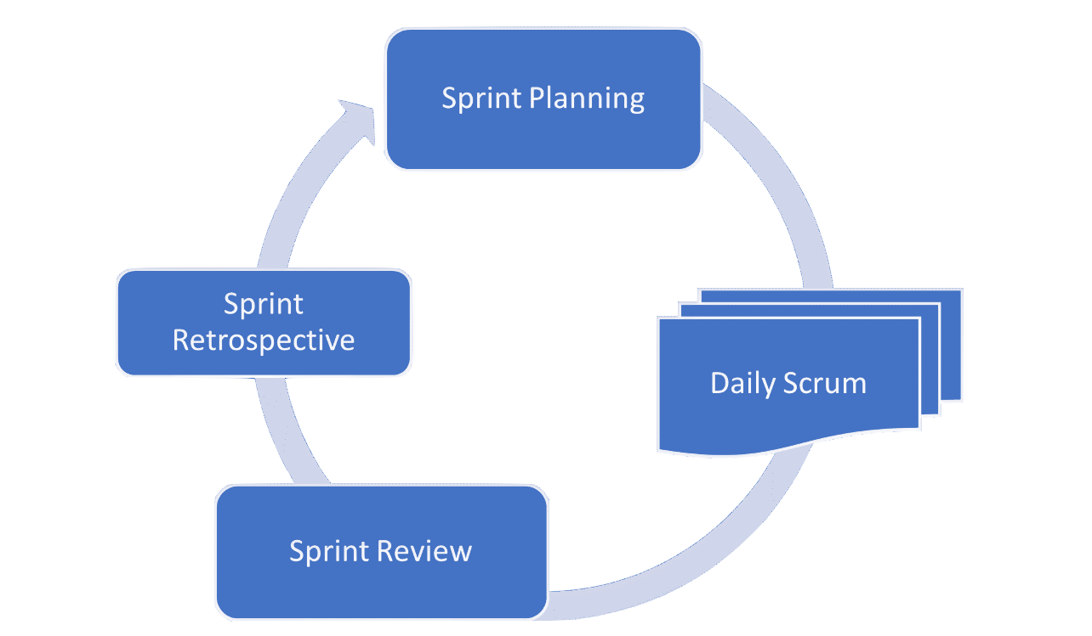
Scrum
Scrum Ceremonies
Scrum prescribes a series of events.
These events recur each sprint and help with tracking tasks as they move from one stage to the next.

Slide 13

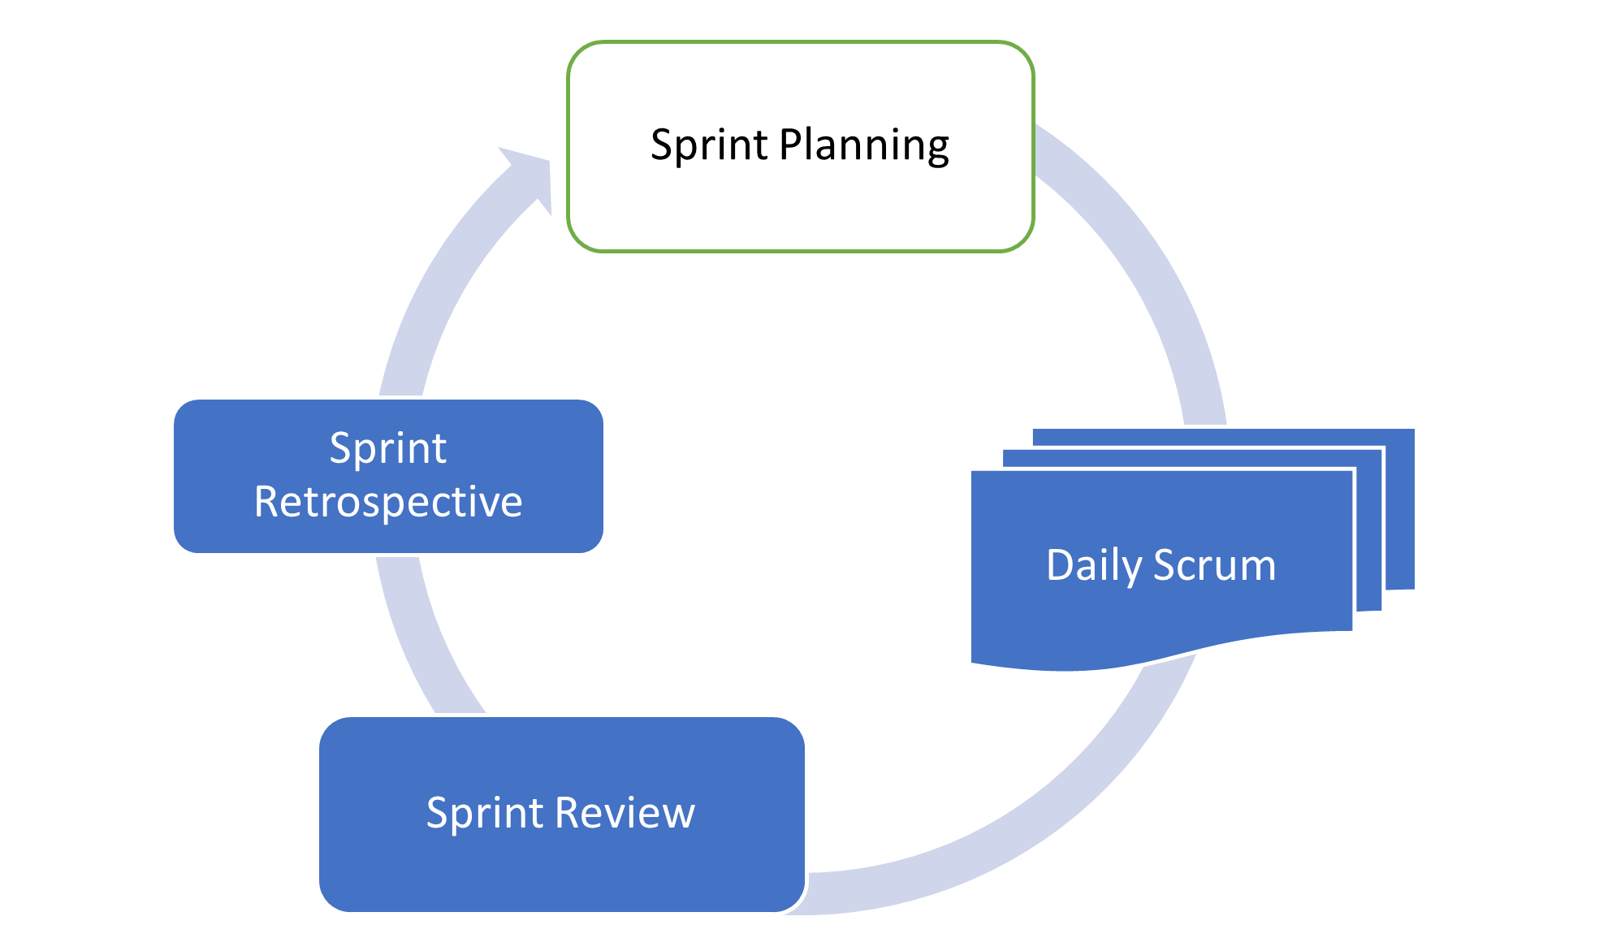
Scrum
1. Sprint Planning
Team members forecast what work they will accomplish during the sprint.
This is where tasks move from the backlog to the sprint backlog.

Slide 14
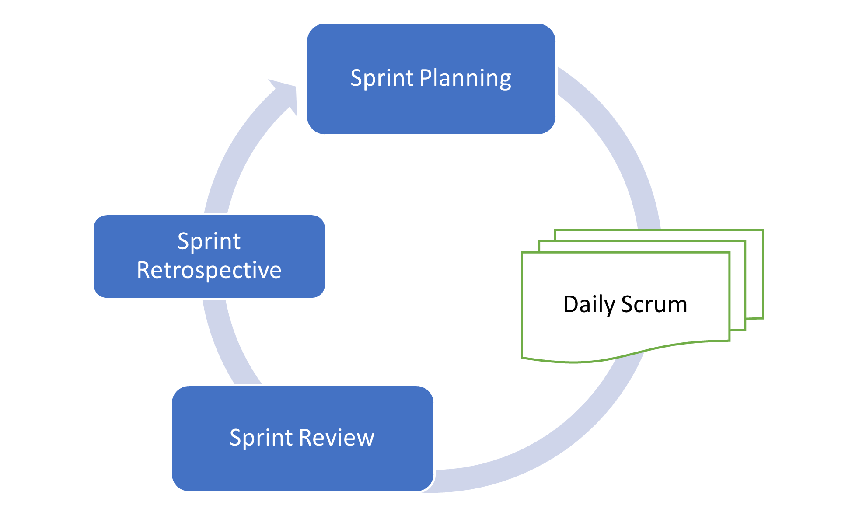
Scrum
2. Daily Scrum
Team members discuss their progress and discover ways to collaborate.
This is where tasks move from the sprint backlog to In Progress to Done.

Slide 15

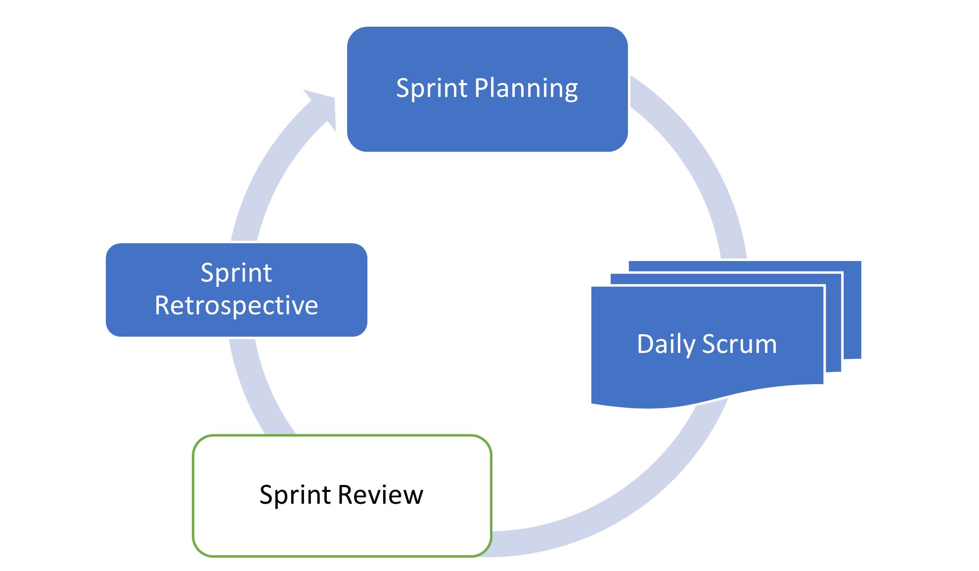
Scrum
3. Sprint Review
Team members review what they've completed.
This is where customers and other outside stakeholders interact with the team and view progress on goals.

Slide 16

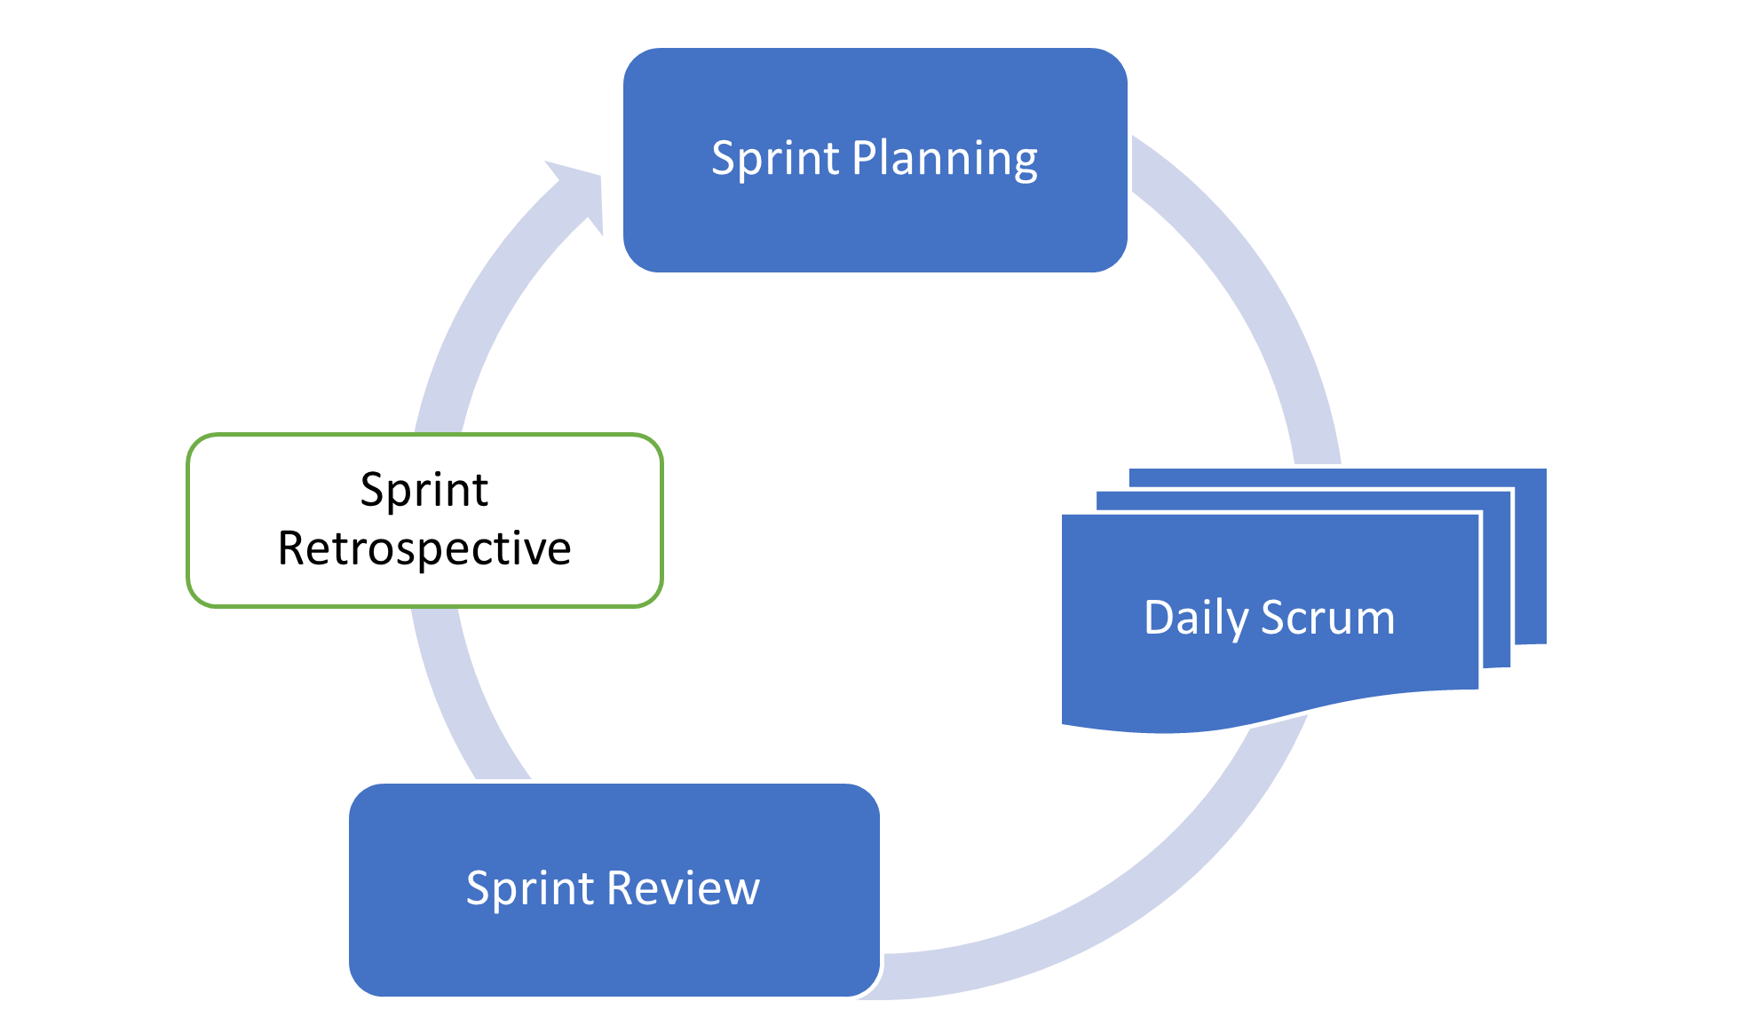
Scrum
4. Sprint Retrospective
Team members reflect on their experience during the sprint and discuss ways to improve as a team.
What went well?
What didn't go well?
What will we do differently next time?
Notes:
This is where the schedule of meetings, number of tasks, and length of future sprints might be adjusted.

Slide 17
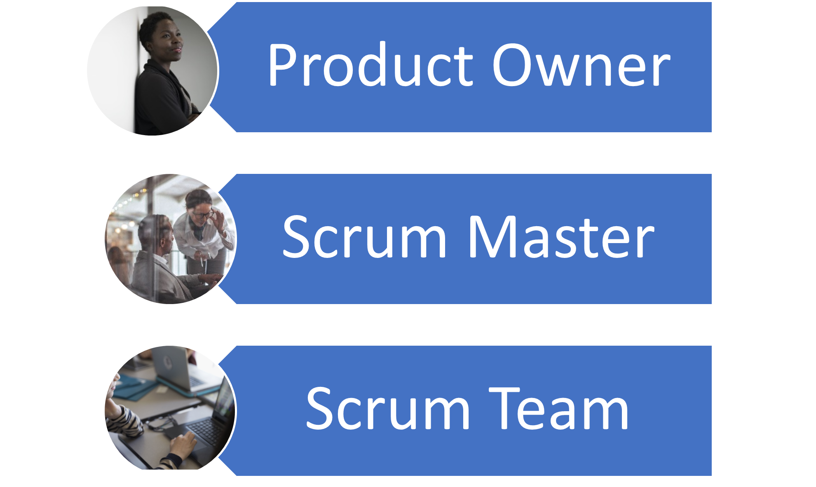
Scrum
Scrum Roles
Scrum prescribes three main roles that relate to each sprint.

Slide 18

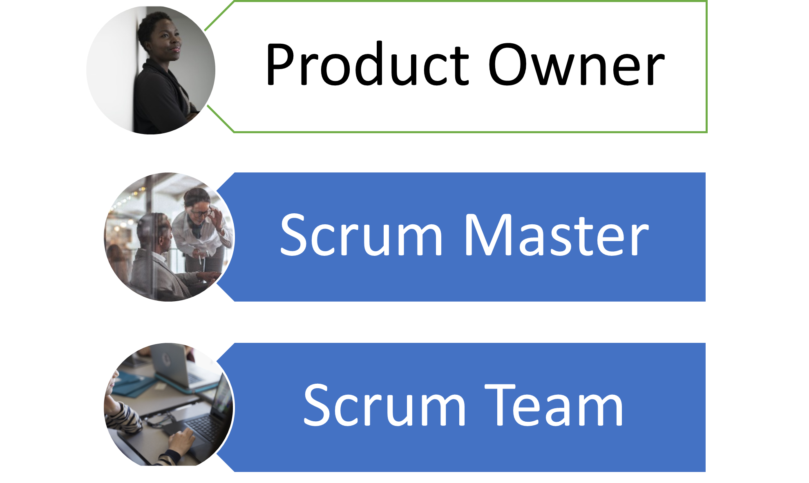
Scrum
Product Owner
Responsible for organizing the backlog
Prioritizing tasks that need to be done in immediate sprints

Slide 19

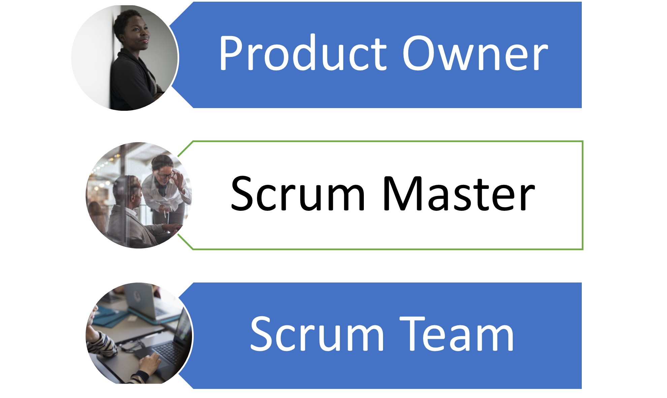
Scrum
Scrum Master
A servant leader of the Scrum team
Removes obstacles that block the Scrum team's progress, facilitates collaboration
Notes:
<< Ask the class what servant leadership looks like to them. >>
<< This is a term that is almost impossible to do justice to with a textbook definition,
so facilitate a conversation that gives examples of servant leaders and how they
differ from traditional leaders. >>

Slide 20

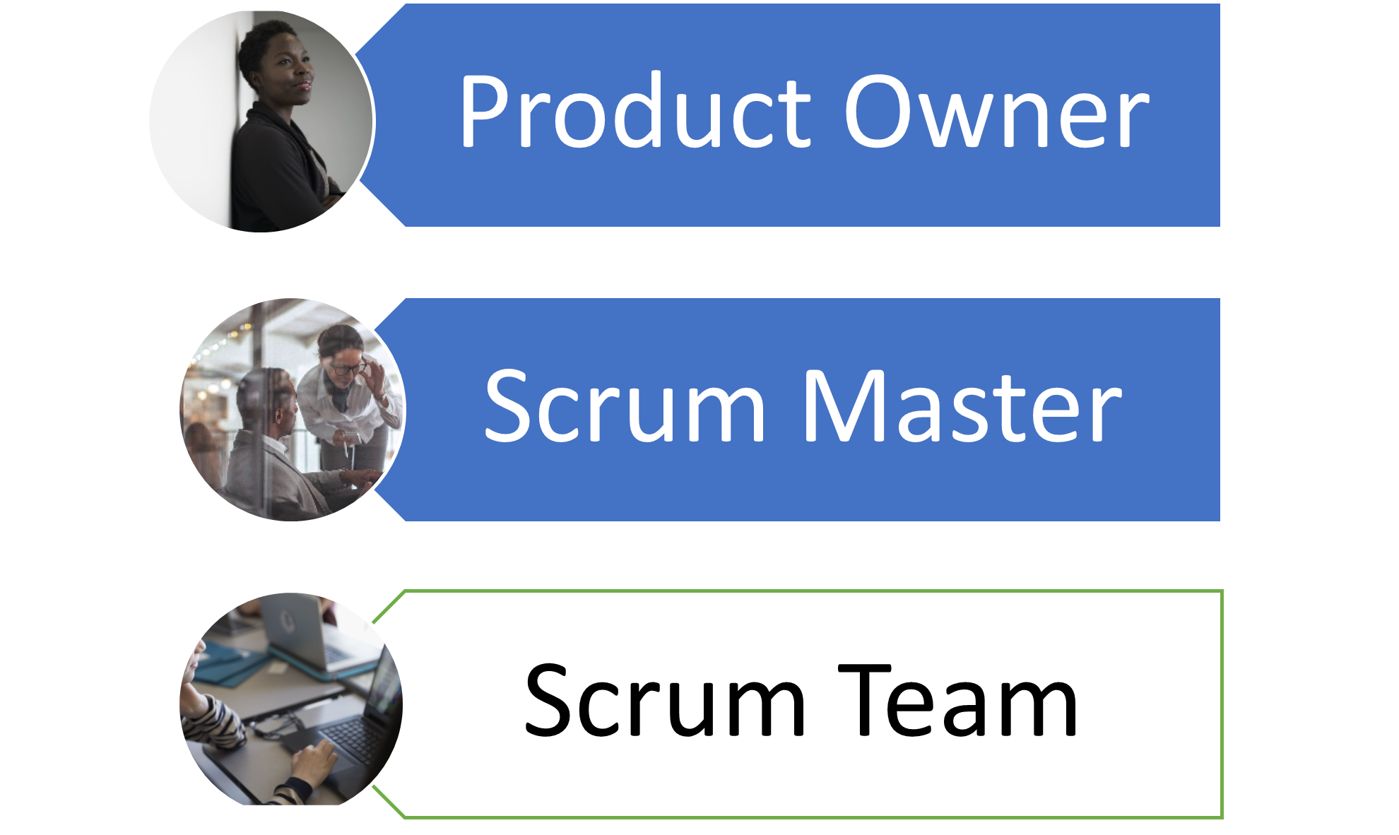
Scrum
Scrum Team
The people directly working on the project
Often a cross-functional team with programmers, designers, and other disciplines

Slide 21
Scrum
Summary
What We've Covered
Agile vs. Scrum
Sprint Lists: Backlog, Sprint Backlog, In Progress, Done
Scrum Ceremonies: Sprint Planning, Daily Scrum, Sprint Review, Sprint Retrospective
Scrum Roles: Product Owners, Scrum Master, Scrum Team
Scrum can be applied to any project.
Let's practice Scrum ceremonies by applying them to tasks in your everyday life.

